Slide 1

307307 Part 3 – Introduction to Large Language Models

Slide 2
What is a Large Language Model?
A Large Language Model (LLM) is an advanced artificial intelligence system trained on vast amounts of text data to understand, generate, and manipulate human language. These models use deep learning, particularly transformers, to predict and generate text in a coherent and context-aware manner.
Key features:
Trained on billions of words from books, articles, and the internet.
Can perform tasks like translation, summarization, code generation, and answering questions.
Examples include GPT-4, ChatGPT, BERT, PaLM, LLaMA, and Claude.
LLMs power modern AI applications, including chatbots, virtual assistants, and content creation tools.

Slide 3
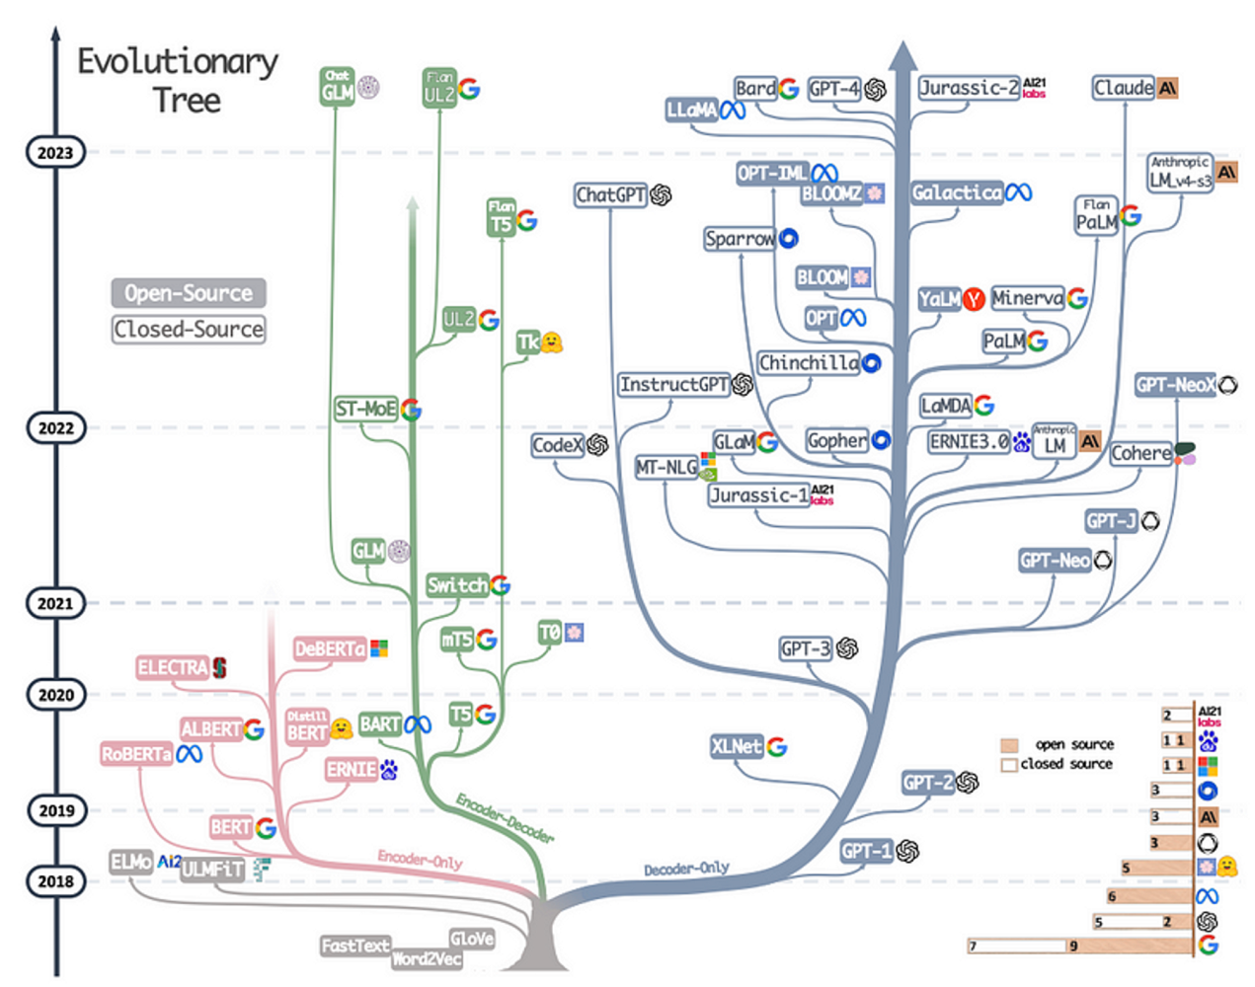
Evolution of Large Language Models
The image is an evolutionary tree of natural language processing (NLP) models, showing their development from 2018 to 2023. It categorizes models into open-source (light color) and closed-source (darker color), tracking major advancements in transformer-based architectures.
Key highlights:
Early models (2018-2019): Word embeddings like Word2Vec, FastText, GloVe, evolving into transformer-based models like BERT, RoBERTa, and XLNet.
Growth in 2020-2021: Expansion into encoder-only (e.g., ELECTRA, ALBERT), encoder-decoder (e.g., T5, BART), and decoder-only models (GPT-2, GPT-3).
2022-2023 advancements: Introduction of ChatGPT, GPT-4, Claude, PaLM, LLaMA, Bard, BLOOM, and more, reflecting both research-driven (open-source) and commercial (closed-source) efforts.
The diagram illustrates the competition and innovation between Google, OpenAI, Meta, AI21 Labs, and Anthropic, among others.

Slide 4
The Basics of Attention
At its simplest, attention is a way for a model to focus on relevant parts of input when producing output.
Think of it as how humans pay attention to specific words or ideas in a conversation while ignoring irrelevant details.

Slide 5
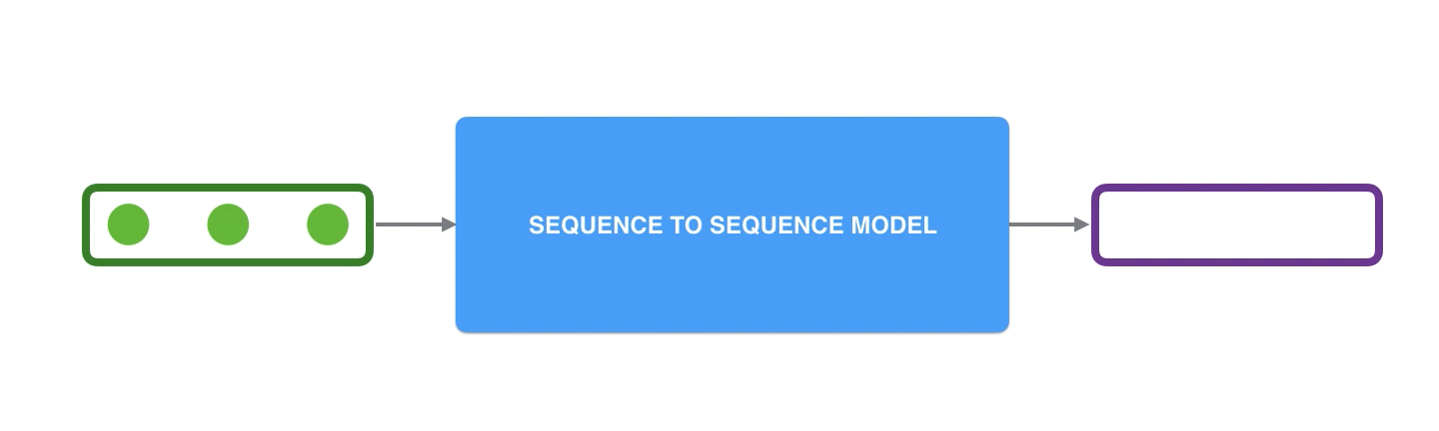
Sequence to Sequence Models
A sequence-to-sequence model is a model that takes a sequence of items (words, letters, features of an images…etc) and outputs another sequence of items. A trained model would work like this:

Slide 6
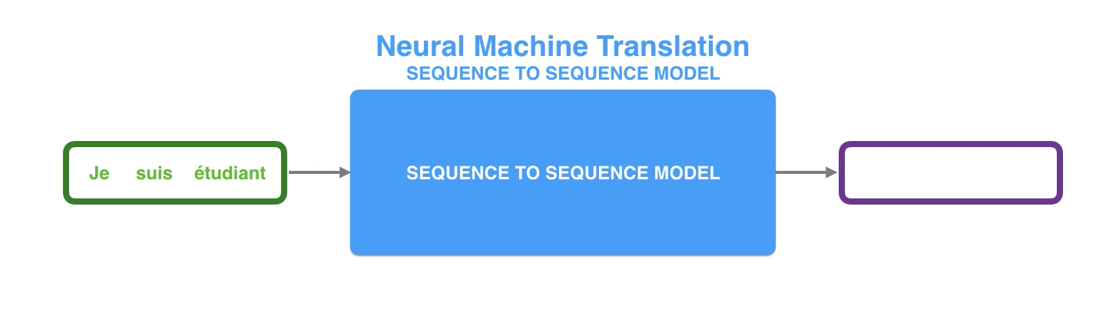
Neural Machine Translation
In neural machine translation, a sequence is a series of words, processed one after another. The output is, likewise, a series of words:

Slide 7
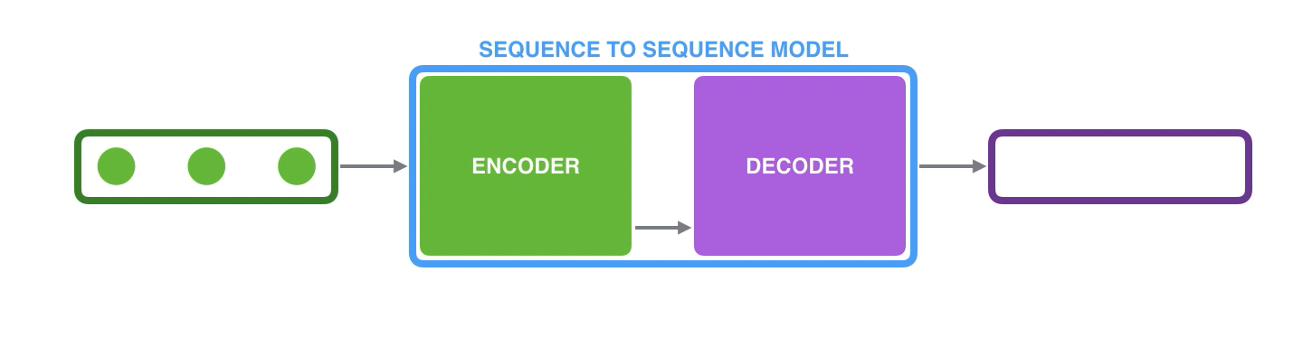
Looking Under the Hood
Under the hood, the model is composed of an encoder and a decoder.
The encoder processes each item in the input sequence, it compiles the information it captures into a vector (called the context). After processing the entire input sequence, the encoder sends the context over to the decoder, which begins producing the output sequence item by item.

Slide 8
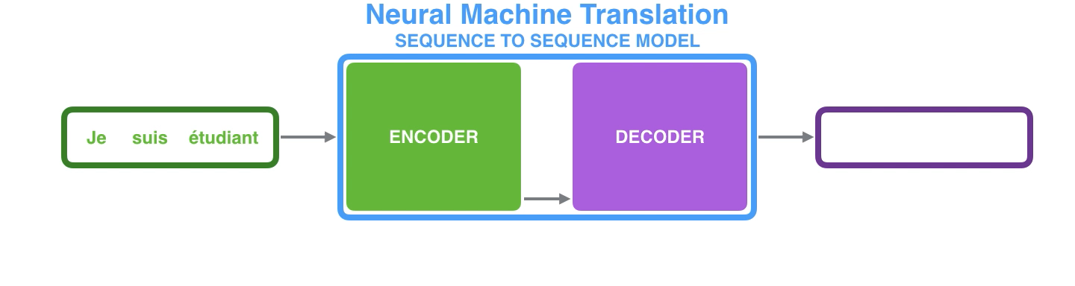
The same applies in the case of machine translation.

Slide 9
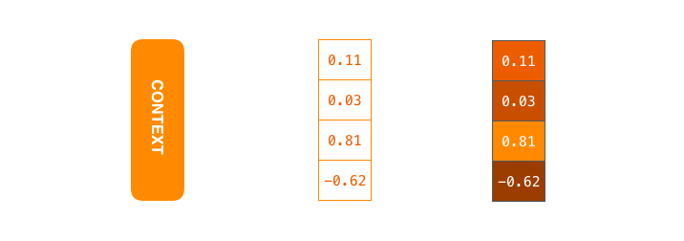
Text Context
The context is a vector (an array of numbers, basically) in the case of machine translation. The encoder and decoder tend to both be recurrent neural networks (Be sure to check out Luis Serrano’s A friendly introduction to Recurrent Neural Networks for an intro to RNNs).
The context is a vector of floats. Later in this post we will visualize vectors in color by assigning brighter colors to the cells with higher values.
You can set the size of the context vector when you set up your model. It is basically the number of hidden units in the encoder RNN. These visualizations show a vector of size 4, but in real world applications the context vector would be of a size like 256, 512, or 1024.

Slide 10
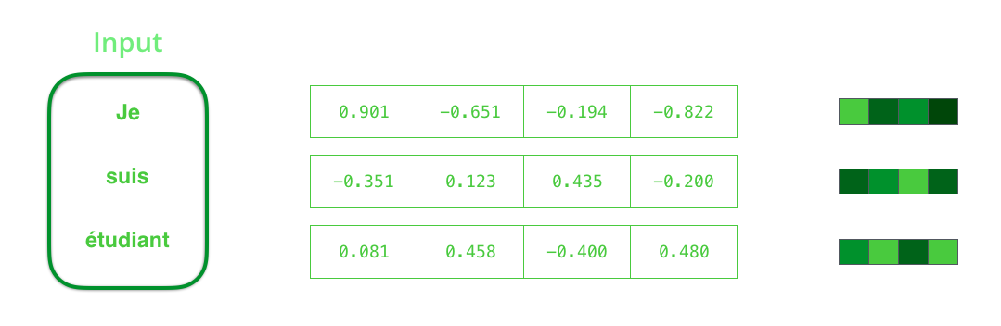
By design, a RNN takes two inputs at each time step: an input (in the case of the encoder, one word from the input sentence), and a hidden state.
The word, however, needs to be represented by a vector.
To transform a word into a vector, we turn to the class of methods called “word embedding” algorithms.
These turn words into vector spaces that capture a lot of the meaning/semantic information of the words (e.g. king - man + woman = queen).
We need to turn the input words into vectors before processing them. That transformation is done using a word embedding algorithm. We can use pre-trained embeddings or train our own embedding on our dataset. Embedding vectors of size 200 or 300 are typical, we're showing a vector of size four for simplicity.

Slide 16
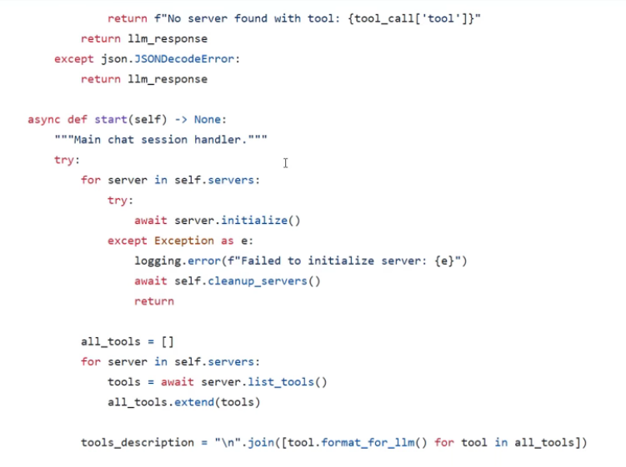
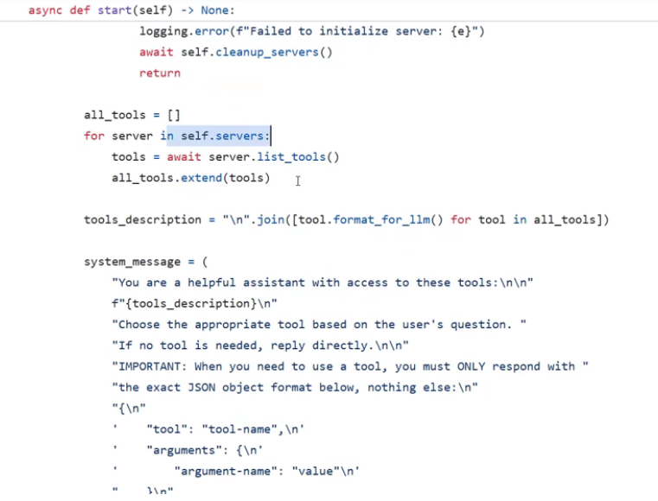
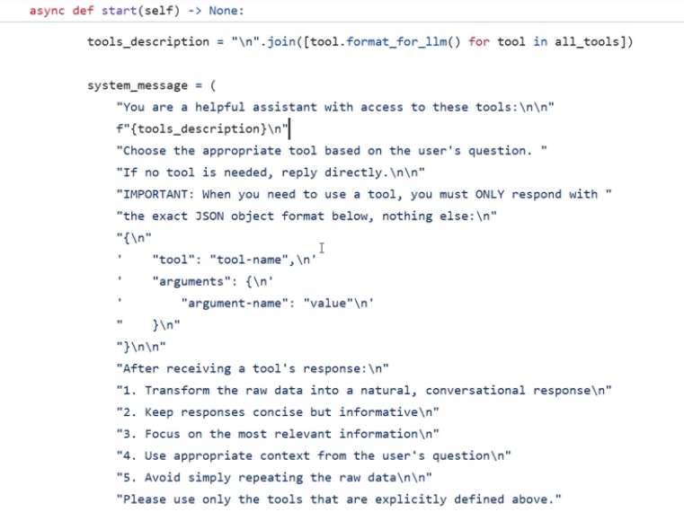
MCP Client Code Shared by Anthropic
Useful Links:
Youtube Video: https://www.youtube.com/watch?v=tzrwxLNHtRY
MCP Website: https://modelcontextprotocol.io/introduction
Sample MCP client: https://github.com/modelcontextprotocol/python-sdk/blob/main/examples/clients/simple-chatbot/mcp_simple_chatbot/main.py Google maps MCP server: https://github.com/modelcontextprotocol/servers/blob/main/src/google-maps/index.ts#L297 MCP Schema: https://github.com/modelcontextprotocol/specification/blob/main/schema/2024-11-05/schema.ts
Simple tool, resource, prompt servers: https://github.com/modelcontextprotocol/python-sdk/tree/main/examples/servers
Example servers: https://modelcontextprotocol.io/examples
MCP inspector (postman like tool): https://modelcontextprotocol.io/docs/tools/inspector

Slide 17
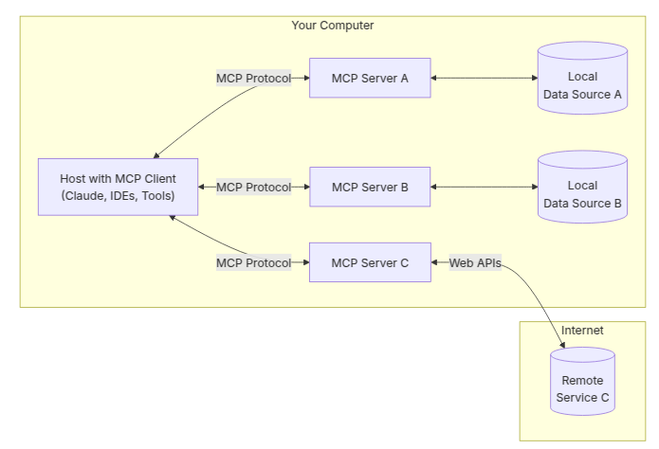
Why MCP?
MCP helps you build agents and complex workflows on top of LLMs. LLMs frequently need to integrate with data and tools, and MCP provides:
A growing list of pre-built integrations that your LLM can directly plug into
The flexibility to switch between LLM providers and vendors
Best practices for securing your data within your infrastructure
General architecture
At its core, MCP follows a client-server architecture where a host application can connect to multiple servers:
MCP Hosts: Programs like Claude Desktop, IDEs, or AI tools that want to access data through MCP
MCP Clients: Protocol clients that maintain 1:1 connections with servers
MCP Servers: Lightweight programs that each expose specific capabilities through the standardized Model Context Protocol
Local Data Sources: Your computer’s files, databases, and services that MCP servers can securely access
Remote Services: External systems available over the internet (e.g., through APIs) that MCP servers can connect to
https://modelcontextprotocol.io/introduction

Slide 18
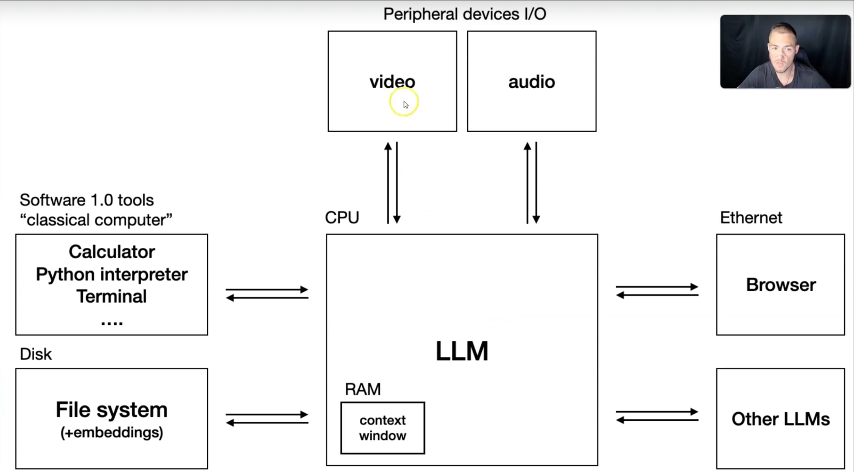
LLM Agents

Slide 19
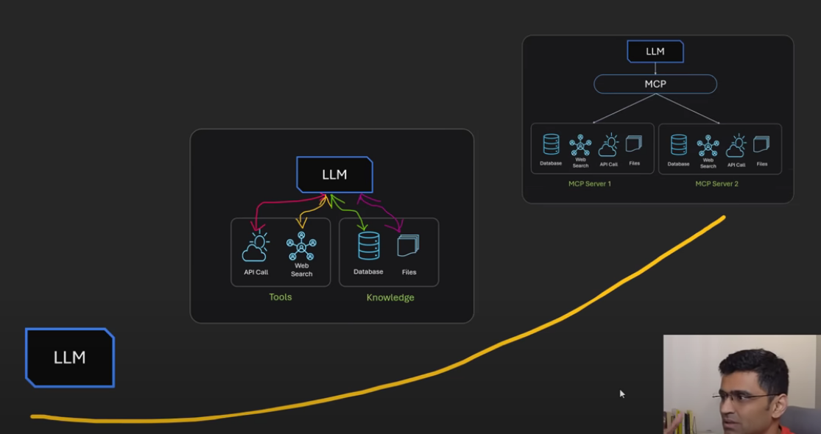
Model Context Protocol (MCP)

Slide 20
References
https://jalammar.github.io/visualizing-neural-machine-translation-mechanics-of-seq2seq-models-with-attention/

